Slide 1
Developing for SQL Server with Docker
Notes:
Survey of attendees developing against SQL Server, then of those using VMs or local instance installs

Slide 2
What is Docker?
A set of software products that provide OS-level virtualization and process isolation
Software is packaged and published as a container
Notes:
The set of software products is multiple items: an API, (sometimes) a Virtual Machine, and a set of file-system changes. The Containers are defined as code, and makes reproducibility much easier than “Install Steps with VM setup”.

Slide 3
What is a Container?
In terms of Docker, a Container is a runtime instance of a Docker Image (more on this later)
Two main types:
Linux Containers
Windows Containers
Notes:
Make a point to note you can have multiple copies of the same process running on the same OS. No need to virtualize the operating system for each container
You save all of the virtualized idle CPU when not virtualizing an OS. Also saving mostly on disk space
Also, no binaries installed on your Host OS, no registry entries for the other servers
Last point, Linux Containers on Windows host uses a Virtual Machine
Open Hyper-V Manager to show the Linux VM for Docker

Slide 4
Docker Containers vs Virtual Machines
Container MS SQL
Container IIS
Container MS SQL 2
Container WCF Services
VM
VM
VM
VM
MS SQL
IIS
MS SQL 2
WCF Svcs
OS
OS
OS
OS
Docker
Host OS
Host OS/Hypervisor
Server
Server
Containers
VMs
Notes:
Points to bring up:
- How large a VM is
- How much memory it takes
- All of the OS-setup jazz
vs.
- Containers are on the same host OS
- They run in their own space
- They take less space than a VM
Differencing Disks can help with space savings, but trying to do Windows Updates with them is a nightmare after a while

Slide 5
Before we try it out, gather these items
We’re going to be using Docker Desktop for Windows (https://www.docker.com/products/docker-desktop)
In order to download the Installer EXE, you’ll need a Docker Hub account (https://hub.docker.com/)
Windows 10 Pro, Enterprise, or Education Edition
This is because of the Hyper-V Windows feature required by Docker
Full list of pre-requisites: https://docs.docker.com/docker-for-windows/install/
Notes:
Bring up that the newest Edge release allows install on Windows 10 Home using WSL2 (https://docs.docker.com/docker-for-windows/edge-release-notes/#docker-desktop-community-2220)

Slide 6
How can I try it out?
1. Open PowerShell
2. Pull (download or diff update) an Image from the Registry (often Docker Hub) docker pull mcr.microsoft.com/mssql/server:2017-latest (https://hub.docker.com/_/microsoft-mssql-server)
3. docker run [OPTIONS] IMAGE [COMMAND] [ARG...] (https://hub.docker.com/_/microsoft-mssql-server)
Notes:
You can run your own Registry too, handy if you want to distribute your own Docker Images at some point. Once you’re at the next slide, demo the pull command.

Slide 7
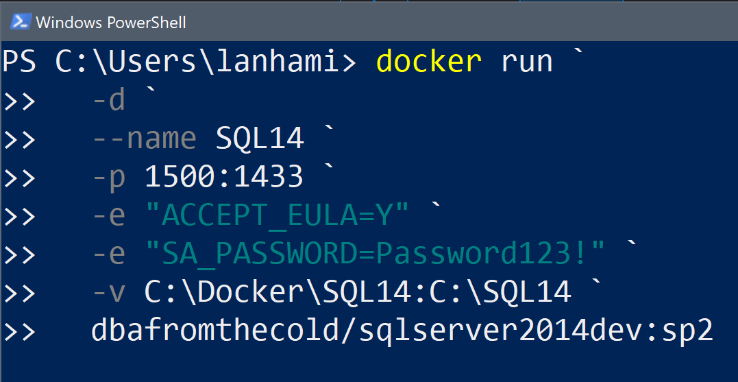
Docker Run Breakdown
Run in Background/as a Daemon
Container Name
Port in my OS:Port inside Container
Environment Variables
Path in my OS:Path inside Container
Image Name to Use:Image Tag
Command template and breakdown source: https://www.cathrinewilhelmsen.net/2018/12/02/sql-server-2019-docker-container/
Notes:
Mention –it instead of –d to run interactively in the CLI
If you don’t give the Container a name, you get a hex string
-e will change for each container you run, i.e. SQL Server environment variables != Postgres environment variables
-v is either mounting a named volume or using a bind mount. Be clear that we’ll cover in a bit, but that topic is the key to persisting data with Containers
Go over the tag after the colon and that those are important. Demo leaving the tag off and the Docker engine doesn’t know what to do with it

Slide 8
Demo #1 – Starting a Container
Start our container (SQL14)
Connect with SSMS
Notes:
When done, switch to Linux Containers for the Settings field

Slide 9
Keeping data from your Container
Three ways to transfer data into and out of your running Containers:
docker cp
Bind Mounts (we used this in Demo #1 with the run command)
Named Volumes
Note: both of the above are added to a container using the –v flag in the docker run command!
Notes:
If I delete a VM, the VHDX files are still there. But if I store files local to the container filesystem and the container is remove, then my data is gone.

Slide 10
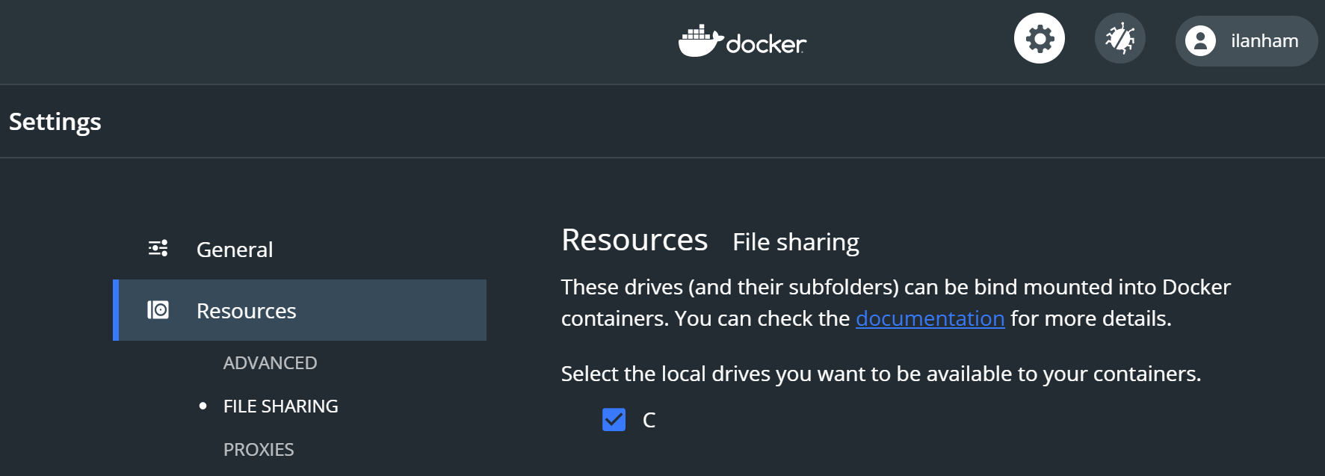
Docker Desktop Settings
In order to start mounting a volume into our Containers, we need to “Right-Click -> Settings” the Docker Desktop app tray icon:
Note: This only applies when running Linux Containers
Notes:
The next slide covers it, but start the explanation that Bind Mounts are necessary when using Linux Containers on Windows hosts

Slide 11
Bind Mount vs Named Volume
Volumes separate the local filesystem path from the logical name of the storage path
Named volumes can use drivers or plugins to go to Azure or S3 storage (to name just a few types)
Bind Mounts make a 1:1 link from local filesystem to the Container’s paths

Slide 12
Bind Mounts and Named Volumes
Guidelines
Linux Containers on Docker for Windows - use a Bind Mount
Windows Containers on Docker for Windows - use Bind Mounts or Named Volumes
Create a named volume: docker volume create test_vol
See where the named volume lives on your OS: docker volume inspect test_vol
Notes:
Go to the path of the named volume after creating

Slide 13
Demo #2 – Mounting a Volume
Check our local path for the bind mount
Copy files into the local path
Show the new files visible to the container

Slide 14
How do I customize a Docker Container?
A couple of different ways:
Create a post-deployment script (.ps1/.bat/.sh/.py)
Often suggested/recommended: create an Image using a Dockerfile
You’ll specify a parent image in a Dockerfile as the source, very similar to a dependency in a Linux package
Notes:
Note that option 1 is the only customization available if the image doesn’t have environment variables exposed/documented

Slide 15
What is a Docker Image?
Docker Images:
Are the basis or source of running a Container (sort-of similar to a DVD ISO)
Consist of an ordered collection of root filesystem changes
Have execution parameters that are run on first creation of a Container
Do not have state
Never change
Often downloaded from Docker Hub
Source: https://docs.docker.com/glossary/
If you want to customize a Docker Image, you specify a source Image, then add your customizations on top

Slide 16
How do we build a Docker Image?
We use a Dockerfile
We’ve been using Andrew Pruski’s (@dbafromthecold) excellent images so far, but I couldn’t find the environment variables to customize
We’ll need to use an official Microsoft image which has some environment variables exposed

Slide 17
Demo #3 – Custom Image with a Dockerfile
We’ll create a Dockerfile based on Image microsoft/mssql-server-windows-developer:2017-latest
We’ll attach a few databases at Container Instance runtime so we don’t need to do so manually

Slide 18
Container and Image Recap
A Container is a way to isolate processes on the OS
It’s a runtime instance of an Image
Image are immutable, and built with a Dockerfile

Slide 19
Questions
E-mail: ilanham@gmail.com
A copy of this presentation is on GitHub: https://github.com/ilanham/Presentations

Slide 20
Credits and Acknowledgements
None of this presentation would be possible without two key sources:
Catherine Wilhelmsen (@catherinew)
Her article on Docker is a great way to get started in a short amount of time https://www.cathrinewilhelmsen.net/2018/12/02/sql-server-2019-docker-container/
Andrew Pruski (@dbafromthecold)
His container series is phenomenal https://dbafromthecold.com/2017/03/15/summary-of-my-container-series/

